Slide 1
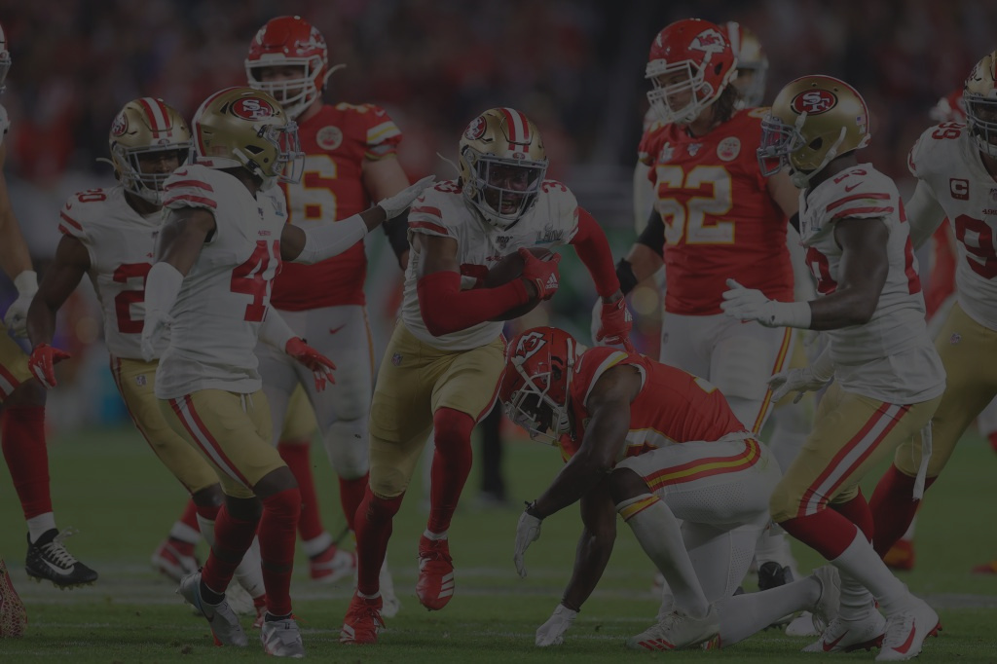

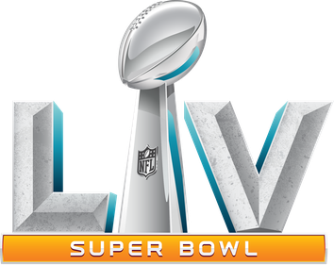
SUPER BOWL
ANALYSIS
A2: GROUP PRESENTATION - TEAM 6
Bhatia Disha
Bianchi Sophie
Chen Tong
Dogru Burcu
Ortega Gonzalo

Slide 2

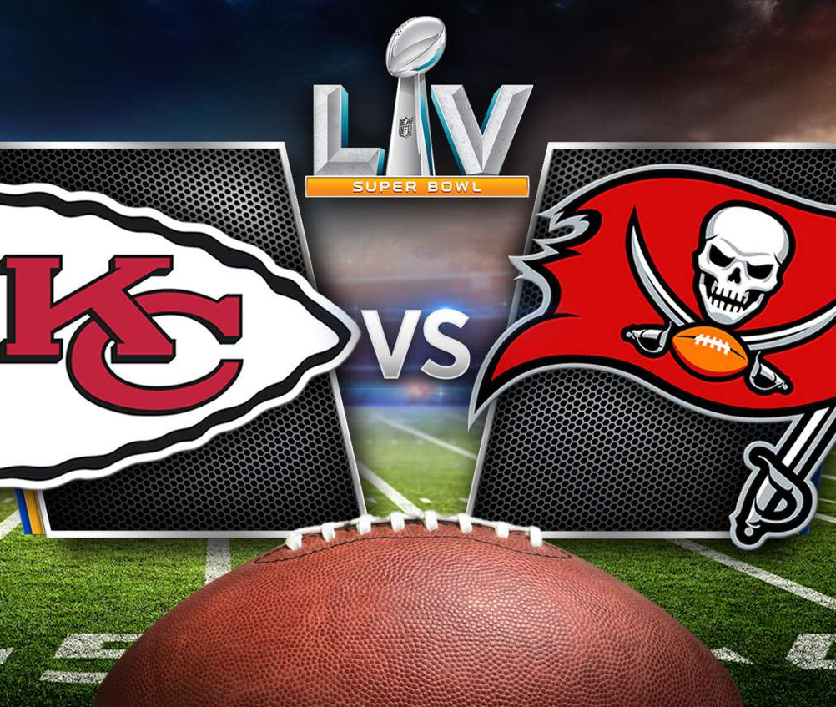
GOAL
Understand if our audience will watch the Super Bowl next year, and if this is the best channel for our promotion

Slide 3

Where we started
SURVEY'S QUESTIONS
01
Please describe how did you spend the Super Bowl day this year
04
On which occasions do you consume beer usually?
02
Please describe places & activities that you go/engage on a regular weekend.
Which national/international sport events do you follow regularly? And please explain why do you like it.
05
03
Please type your alcoholic drinks and beverages preference. (Please specify the name)
06
Are you planning to watch Super Bowl next year?

Slide 4
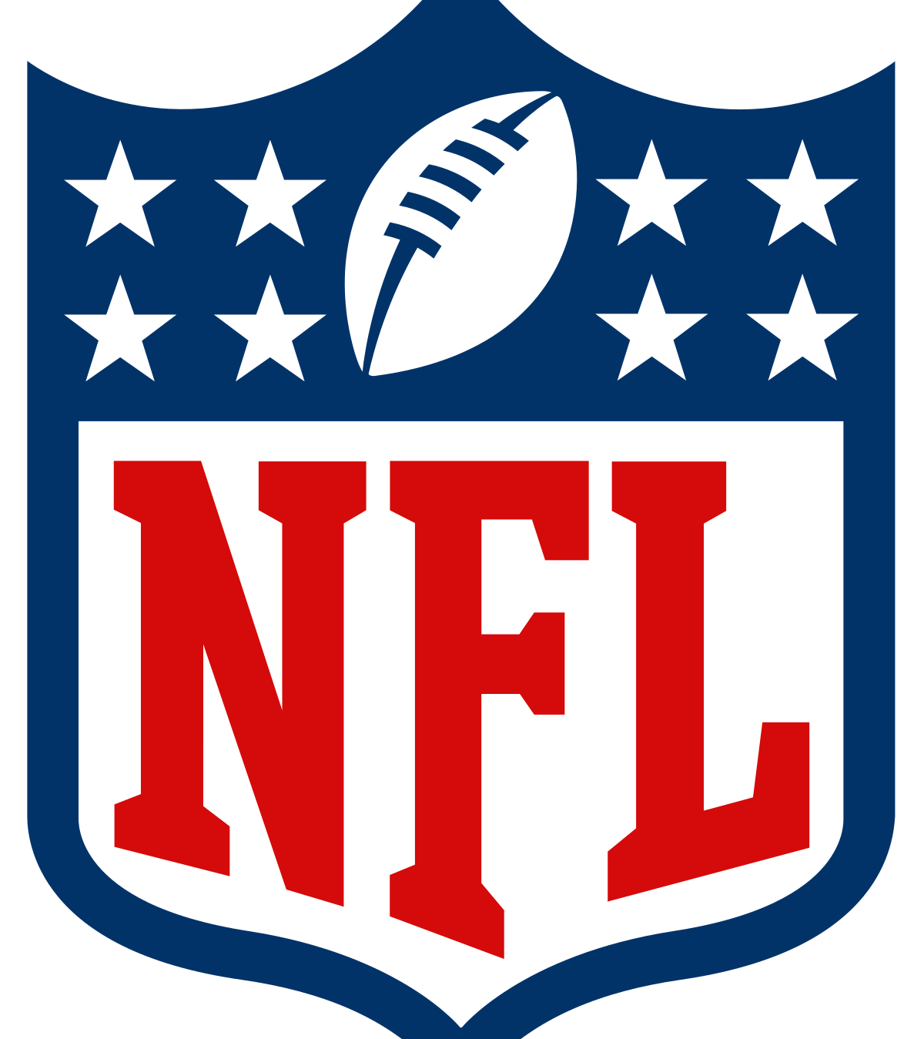
66
Answers
We asked our audience to fill out the survey in the most precise and complete way, in order to create a txt file and conduct our NLP analysis.

Slide 5
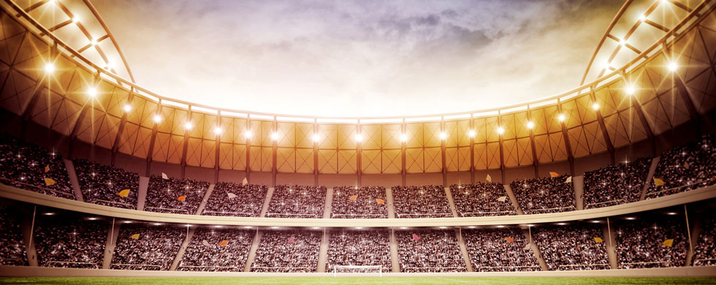

W
R ANALYSIS
We created on R a code to get some insights from our target audience, in particular the sentiments and the frequency of the business success (will watch the Super Bowl next year).

Slide 6
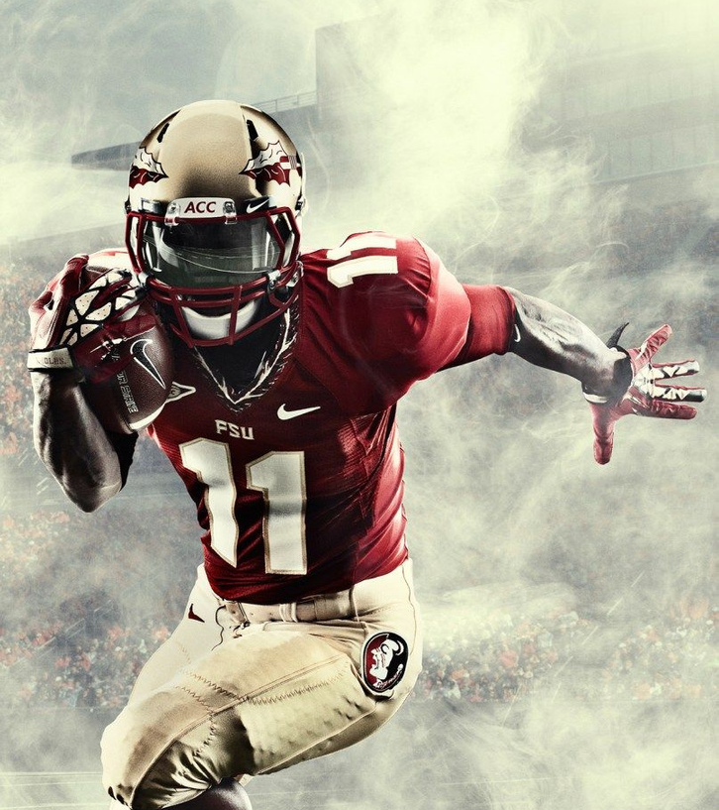
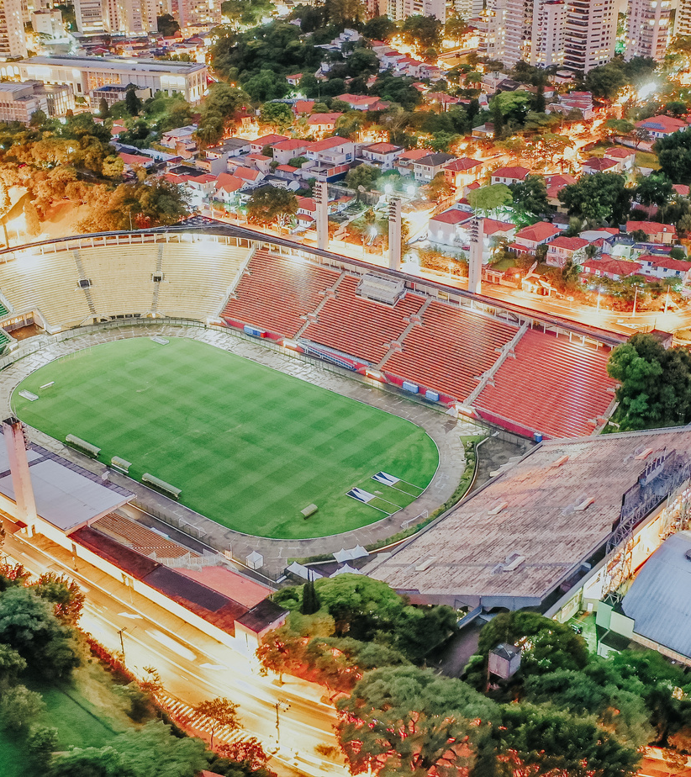
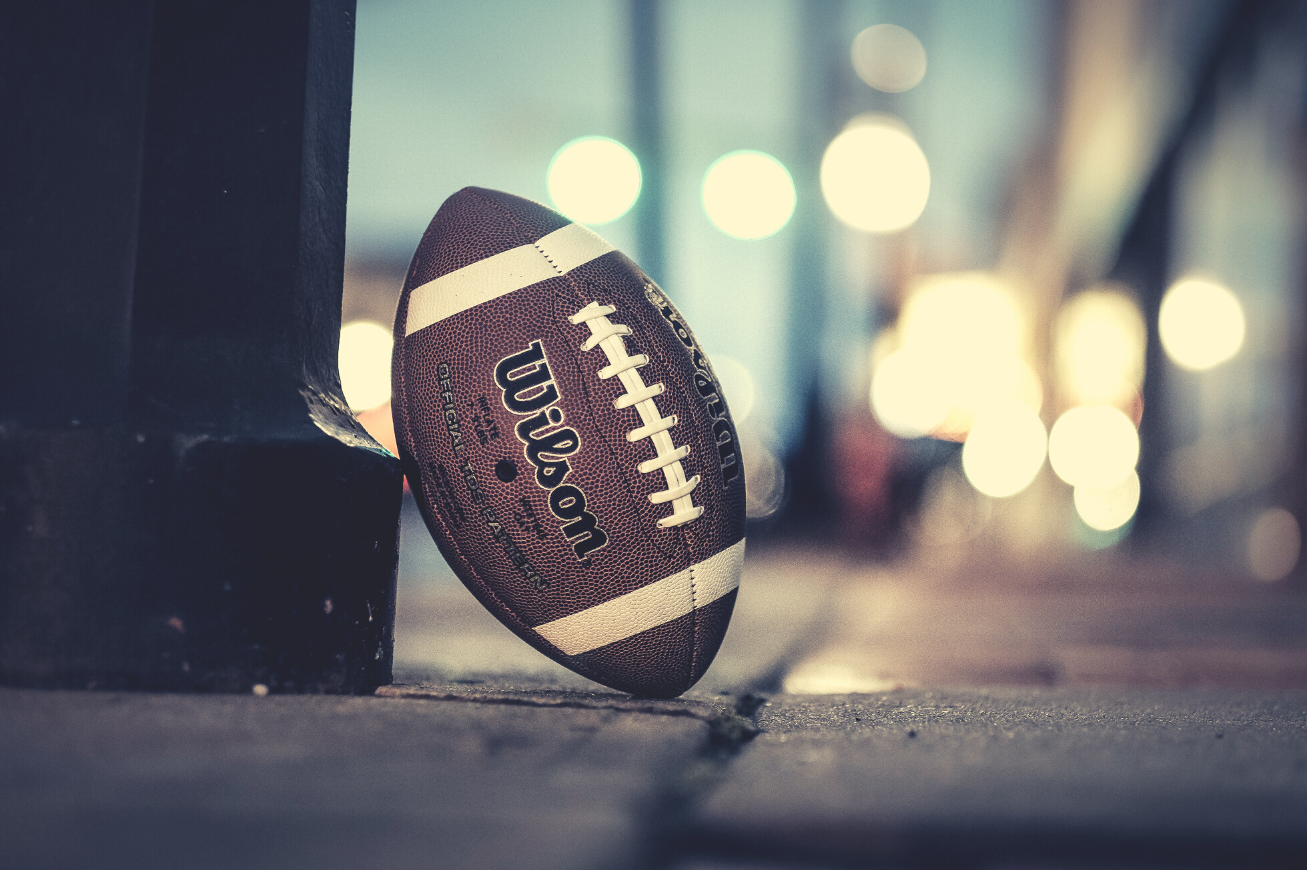
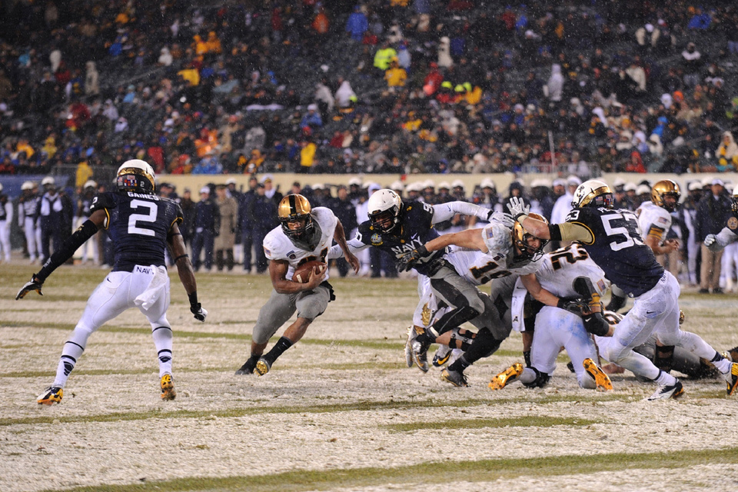
INSIGHTS
Based on our analysis, it doesn’t worth the investment to sign a contract with the NFL for the Super Bowl, as our audience watch many other sports. Our recommended channels are:
Sports channels: air our campaign during the commercial breaks
Ads on YouTube: post videos on match highlights and summaries
Partnerships: sign deals with some of the biggest and most influential Instagram sports pages

Slide 7
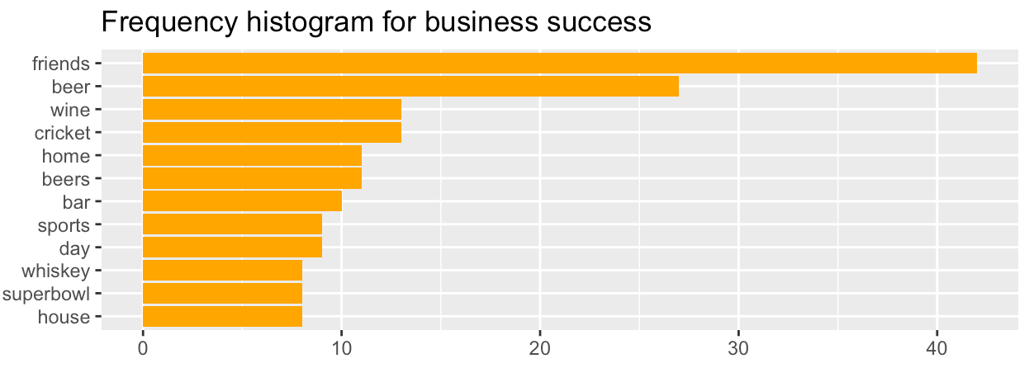
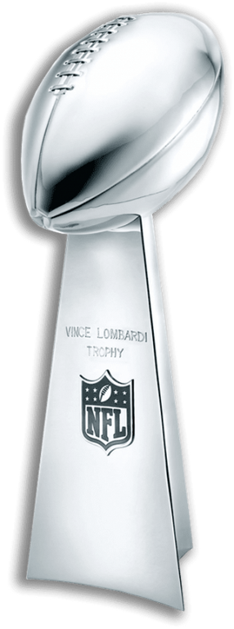
STEP 1
Tokenization and Frequency
Tokenization of the answers
Creation of 2 variables: Business Success vs Business Failure
Identification of the most frequent words for business success and failure
Histogram of the frequencies

Slide 8
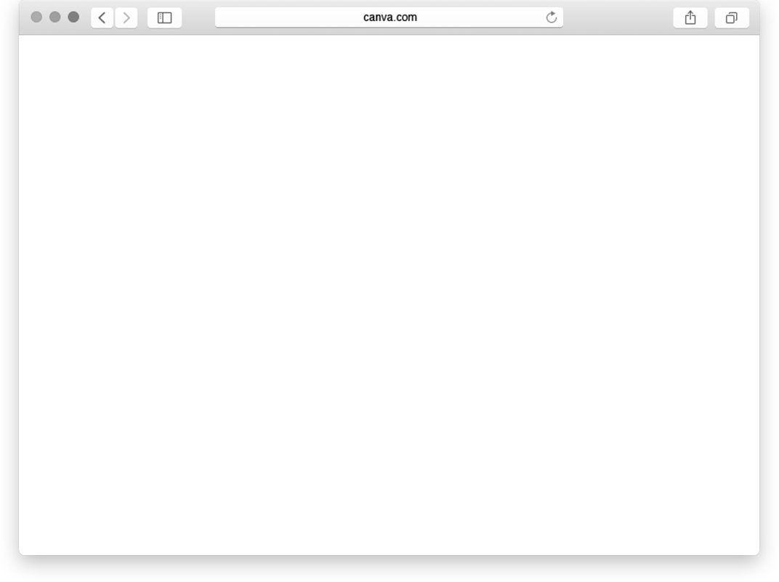
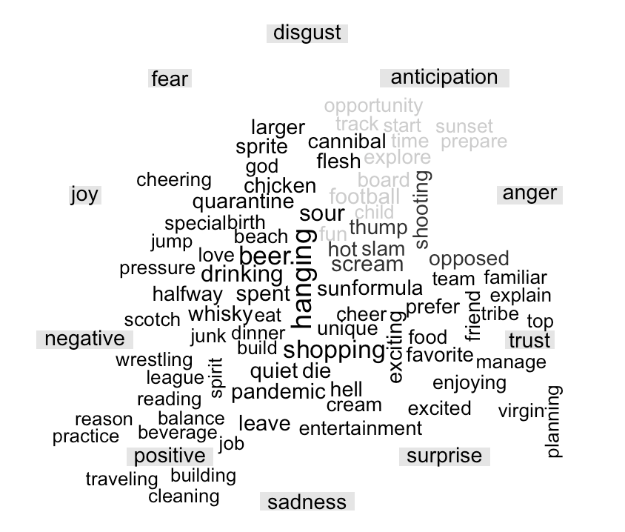
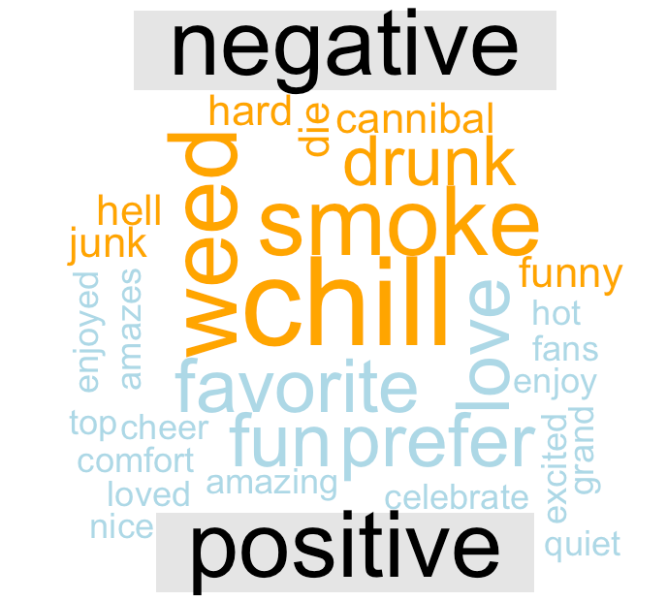
Sentiment Analysis
STEP 2
WORD CLOUD
We create "bing" and "nrc" word cloud to compare positive vs negative sentiments for both business success and failure.

Slide 9
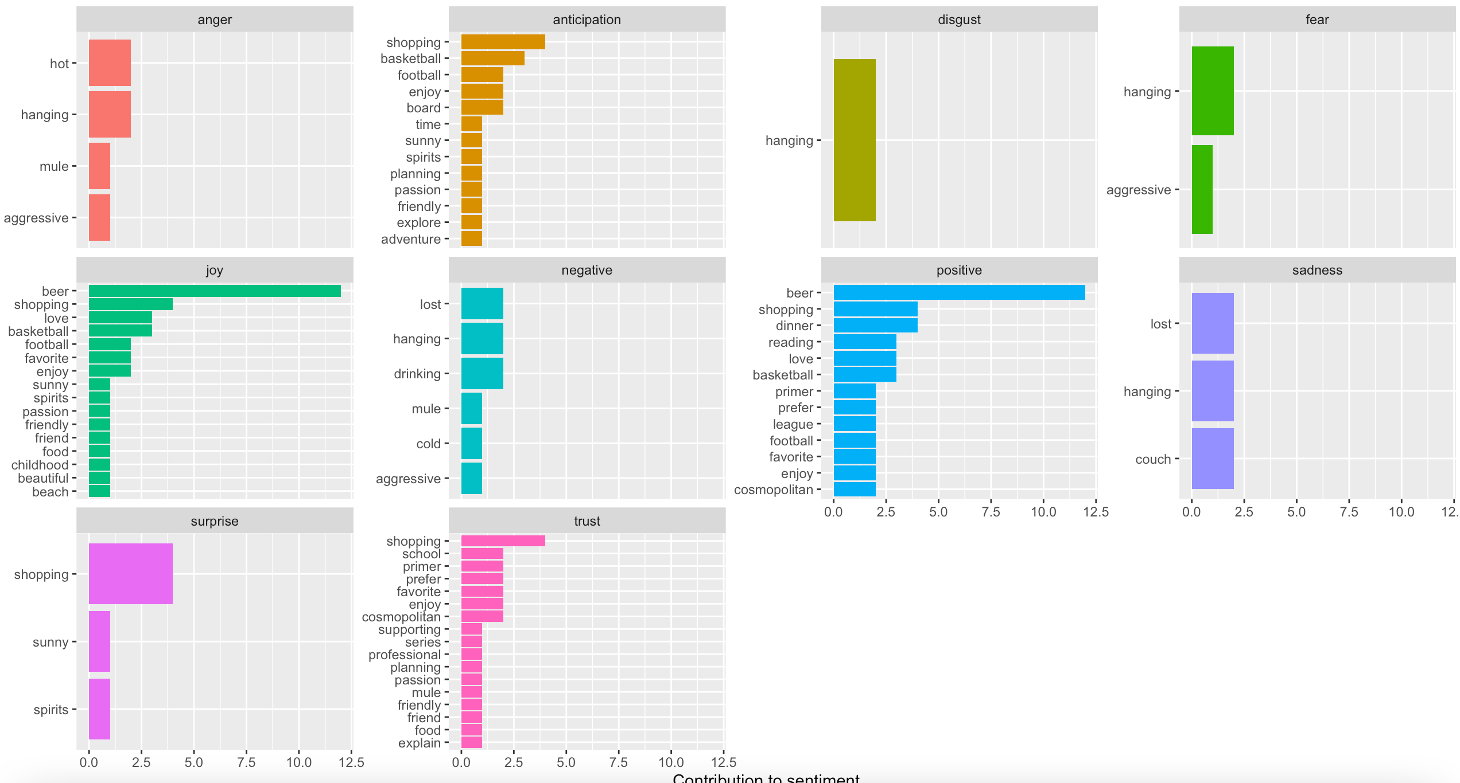
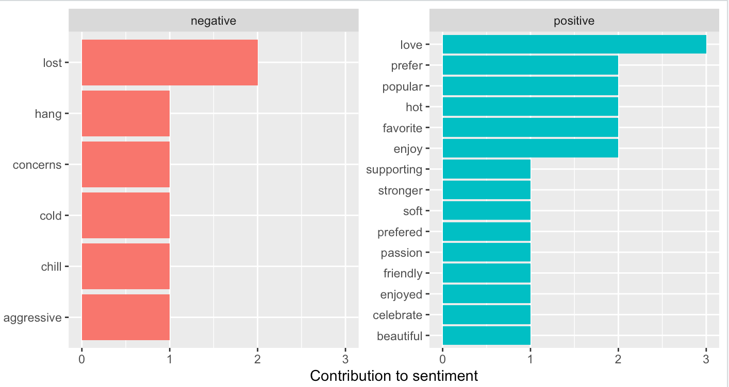
Sentiment Analysis
STEP 3
DISTRIBUTION
We create histograms for both "bing" and "nrc" analysis to see which are the most frequent words with positive/negative sentiment and which emotion they evoke.

Slide 10
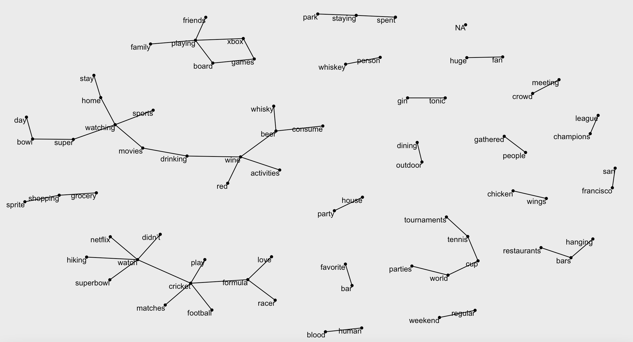
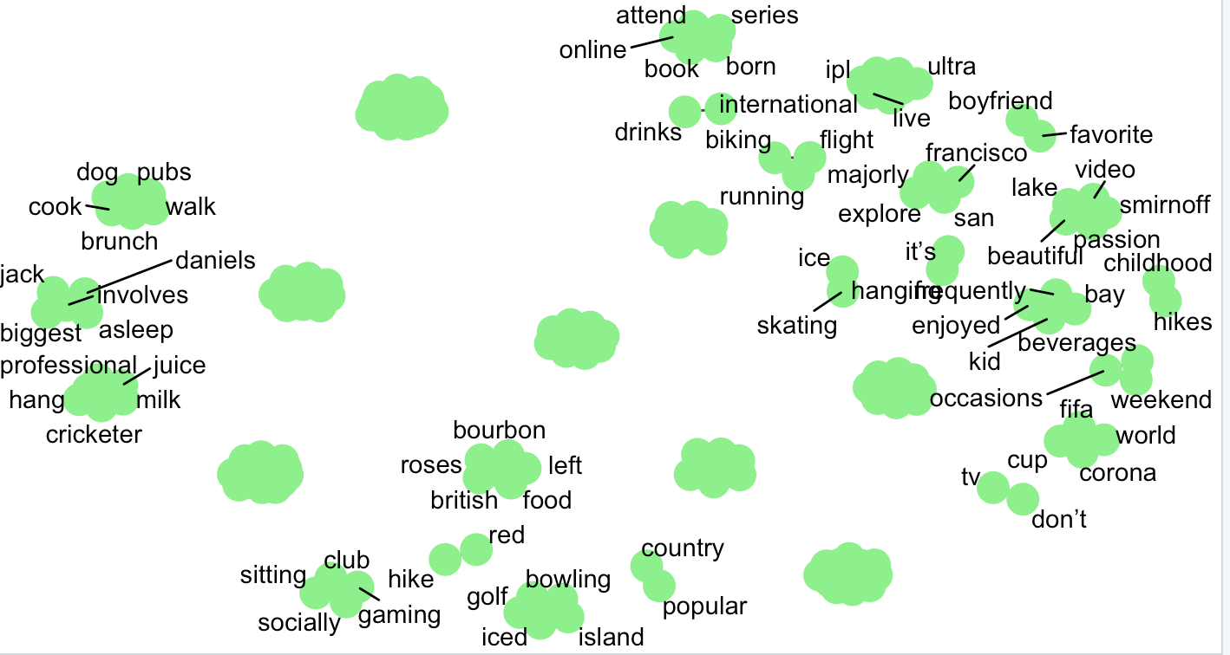
STEP 4
WORD CORRELATION NETWORK
We analyzed the relevance and relationship between the main tokens. have a stronger relationship (relevance). In this way we can determine the possible high-frequency behaviors of users and describe key user portraits.
E.g. watching sport and drinking alcohol are connected.

